Slide 1

Note: The data and information in this document is reflective of a hypothetical situation and client. This document is to be used for KPMG Virtual Internship purposes only.
Sprocket Central Pty Ltd
Data analytics approach

Slide 2
Note: The data and information in this document is reflective of a hypothetical situation and client. This document is to be used for KPMG Virtual Internship purposes only.
Agenda
Introduction
Data Exploration
Model Development
Interpretation

Slide 3
Introduction
Customer Analysis
Analyze the following factors for new customers:
Age Distributions
Number of bike purchased in 3 years / percentage purchases.
Job industry category
Wealth segments
Number of cars own on each states.

Slide 4
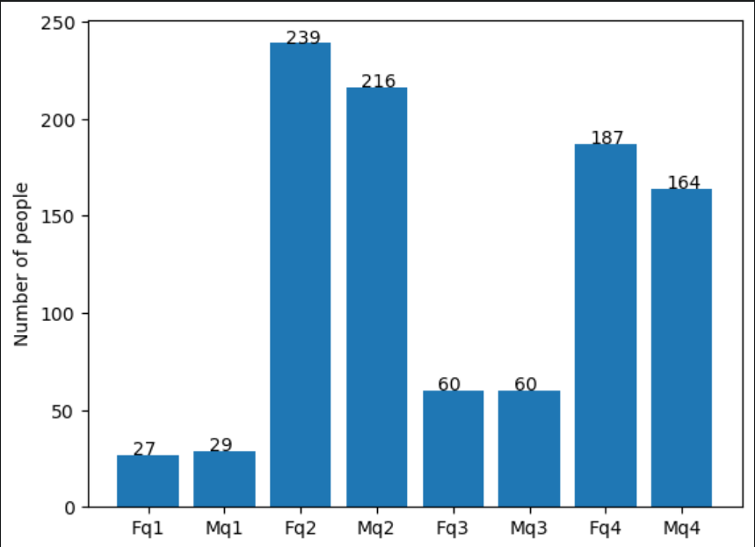
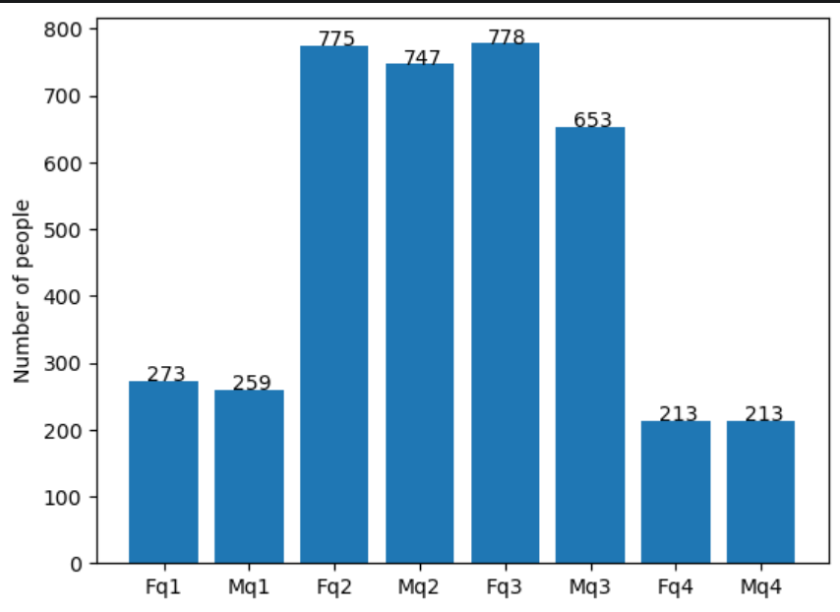
Data Exploration
New
Customers’ Age distribution
As you can see, mostly our new customer are between 25 and 48 years old as the same is noticed for the old customer data also. Hence, we can infer that, people belonging to this group are most likely to purchase frequently.
Number of customers from 48 and 59 years old has big drops on percentage.
There is significantly increase in the number of customer over 59 years old in term of percentages.
Number of people under 25 years old is not really change.
Old

Slide 5
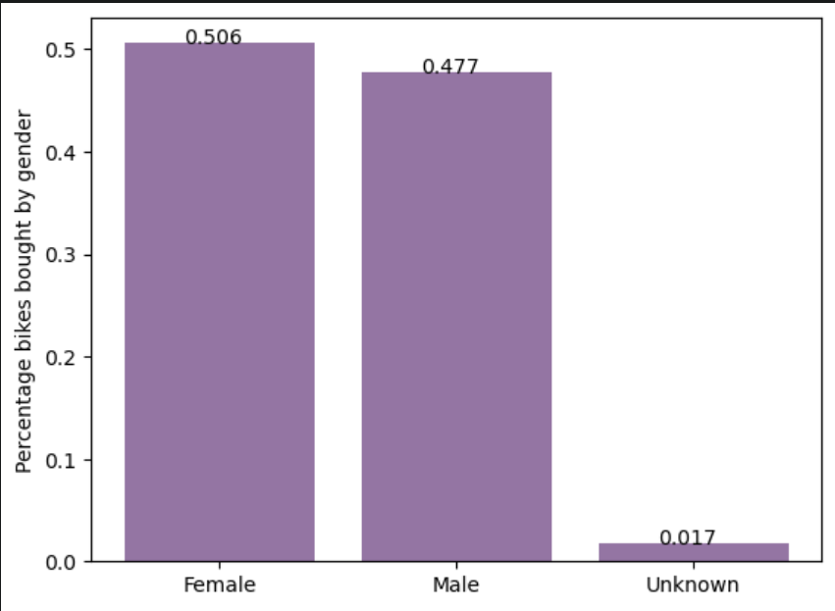
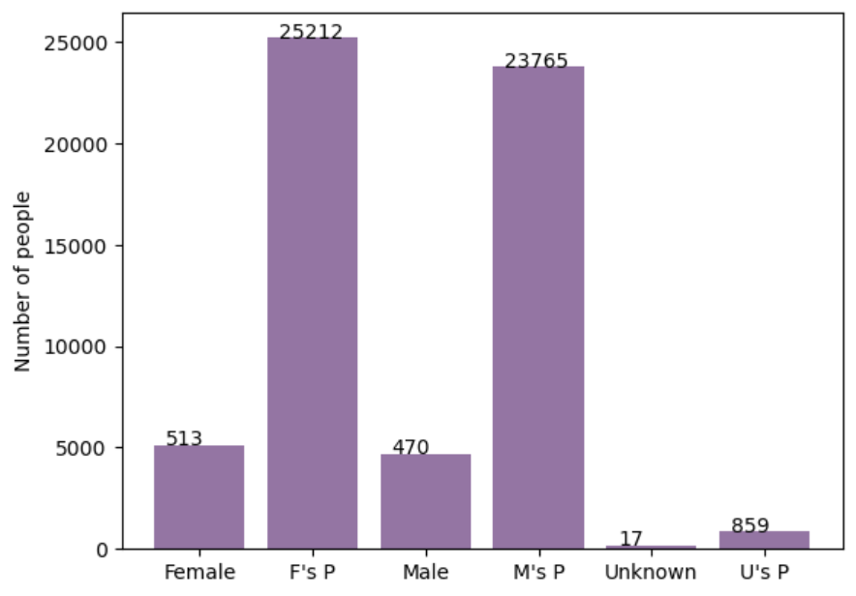
Model Development
Bike purchased last 3 years
As we can see, mostly our new customer are Female with 50.6% purchases with total of 25212 bikes.
Male contributed to 47.7% purchases with 23,765 bikes.
Therefore, the target customer for our marketing strategy should be inclined to provide focus on females than males.

Slide 6
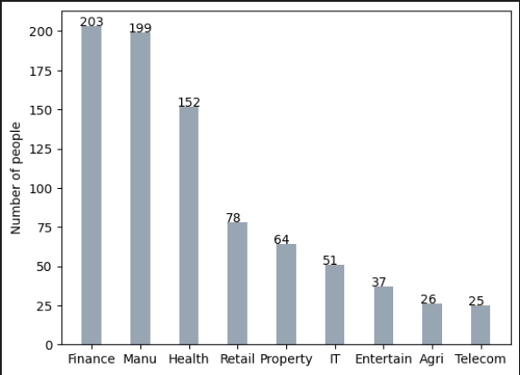
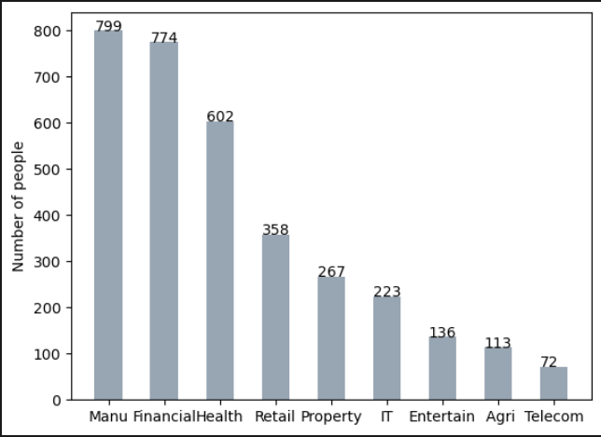
Interpretation
Join industry
Mostly our new customers are on Finance industry and our Manufacturing customers are still on top 2.
Rest of the industries seem to remain in the same positions.

Slide 7
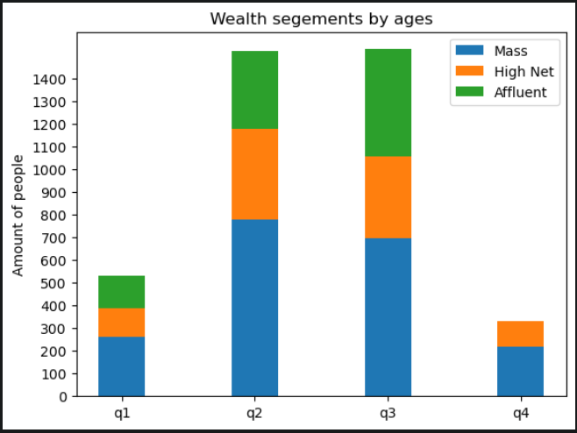
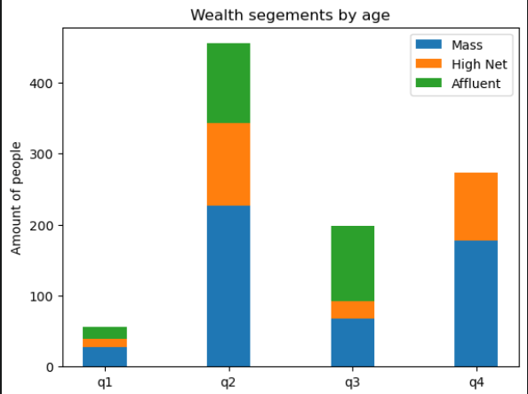
Interpretation
Wealth segments
We notice that in all ages, the number of Mass Customers is the highest so we should provide extra attention on this class.
The next one should be focused is High Net category.
Then followed by Affluent Customers.

Slide 8
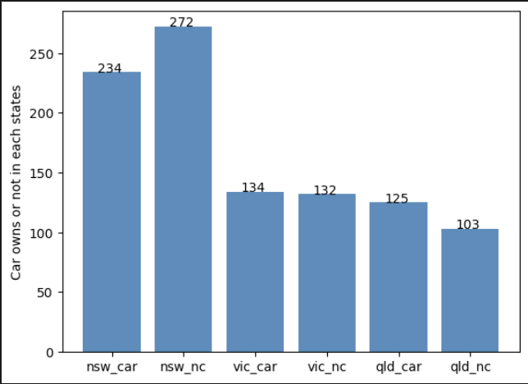
Interpretation
Number of cars owned
VIC and QLD has more customers that own car so NSW should be considered
NSW cars category should be prioritized the most for now, since numbers of customers that don’t own a car is significantly larger than the number of customers who own one.

Slide 9
Note: The data and information in this document is reflective of a hypothetical situation and client. This document is to be used for KPMG Virtual Internship purposes only.
THANK YOU

